Slide 1
Impatiens Necrotic Spot Virus (INSV) and Pythium Wilt of Lettuce
How long has it been a problem:
INSV first identified on Salinas Valley lettuce in 2006
Pythium wilt first report in the Salinas Valley on lettuce in 2015

Slide 2
Impatiens Necrotic Spot Virus (INSV) and Pythium Wilt of Lettuce
In 2020 incidence and severity of both of these diseases increased to unprecedented and catastrophic levels
Could have been related to two heat spells
Although, we have had heat spells in the past and not seen these diseases flair up
2021 elevated levels of these disease continued, but may have been less due to cooler weather conditions – this is unclear

Slide 3
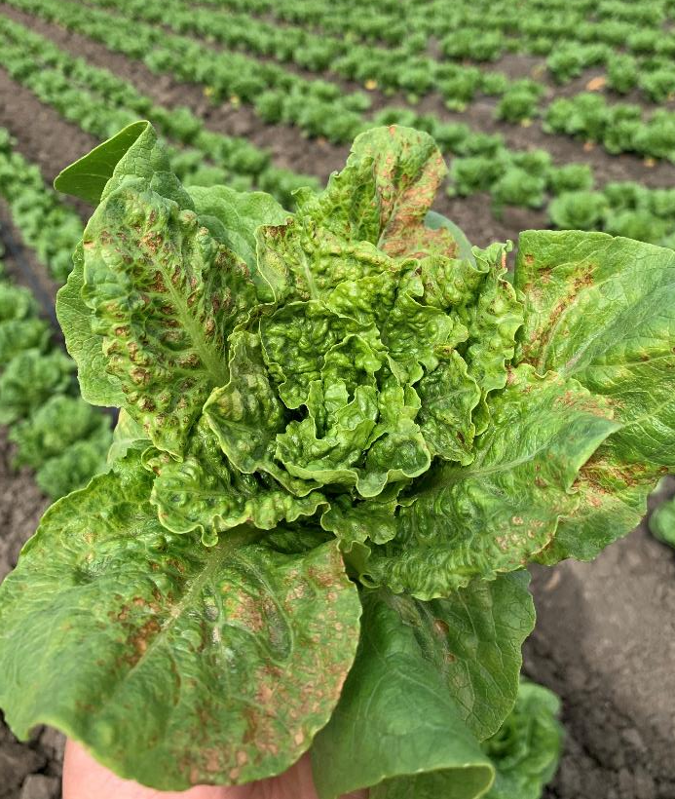
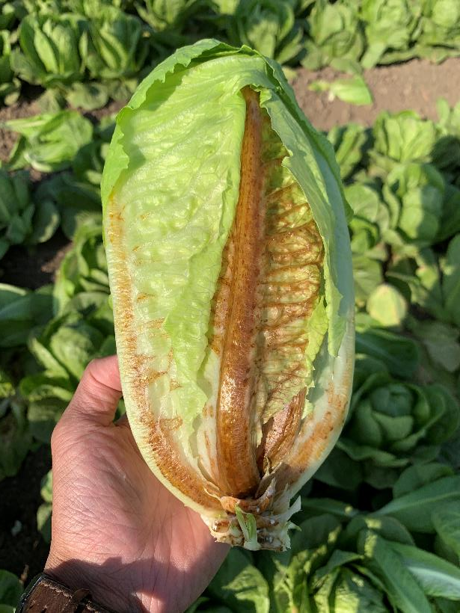
INSV Symptoms
Necrosis on romaine
Internal Necrosis

Slide 4
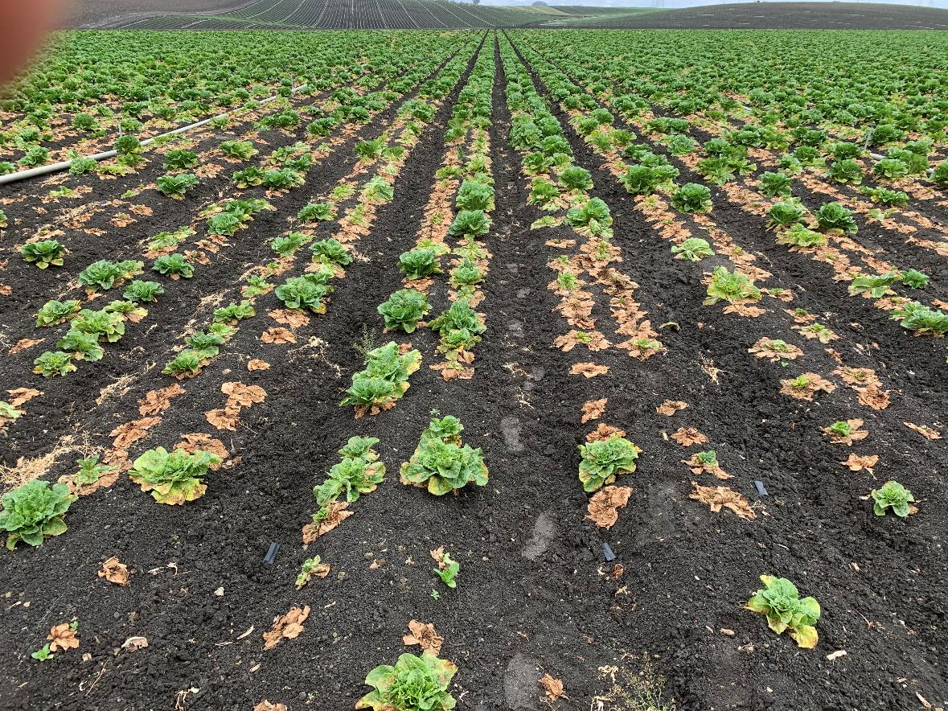
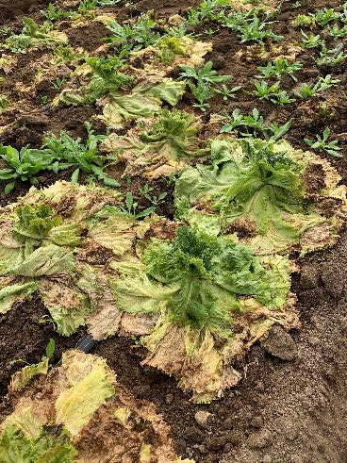
Pythium Wilt Symptoms
Outer leaves die back
Loss of lettuce stand
Rotting of tap root

Slide 5
Control Options for INSV
It is spread by an insect, thrips which complicates control
They are a small insect easily blown long distances by the wind
They are difficult to control in conventional production
Applied for a 24c for Torac but was denied
Organic production in Salinas Valley valued at $757 million
Very limited control options for organic

Slide 6
Control Options for INSV
Controlling weed hosts for this virus in the winter months to break the disease cycle is a key practice
Growers have organized and formed a task force to address weed issues
Working with CalTrans to address weeds on the 101 corridor
Educating growers on the need for fastidious weed control on farms and surrounding areas

Slide 7
Control Options for Pythium Wilt
We have been researching methods for controlling this disease
Fungicide control has been limited due to difficulties of getting the fungicide to all parts of the root system

Slide 8
Research Needs
Continued research is needed
Better understand the epidemiology and biology of these diseases to identify ways to mitigate their impact
Direct control methods such as use of pesticides and biologicals
Better understanding of cultural control methods
Varietal resistance

