Slide 1
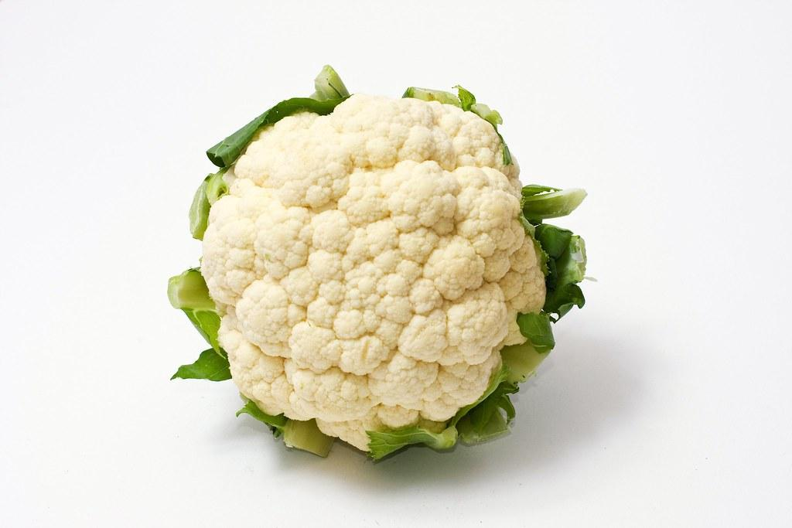
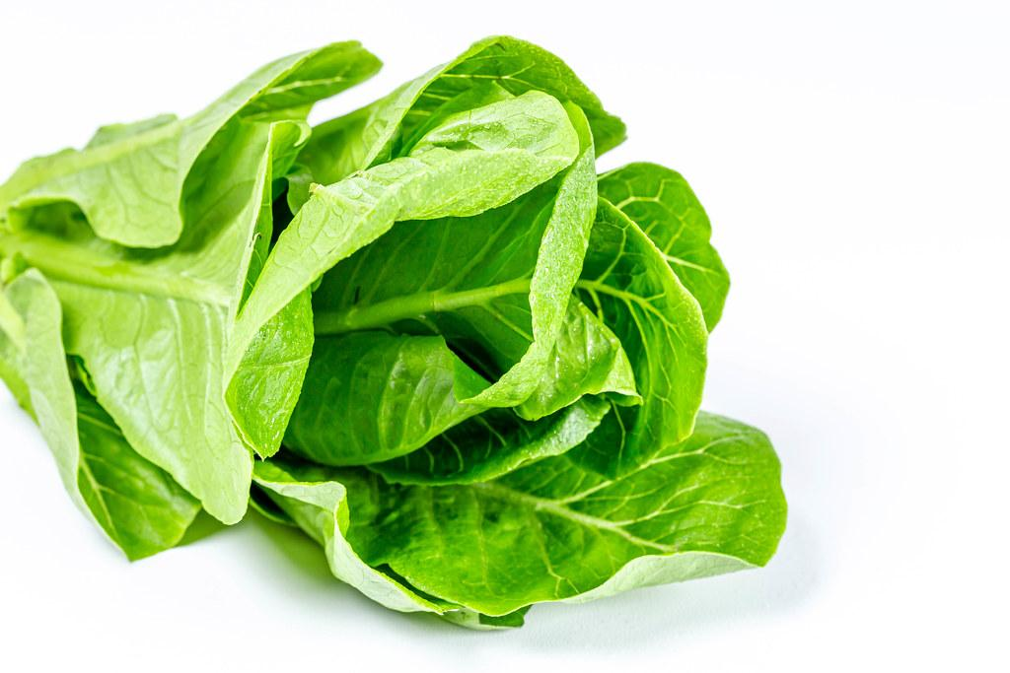
From the Field Insight
Mark Mason
PCA/CCA/Large Grower Shipper
This is a Disaster, It really is
Growers are changing planting locations (this is a guessing game)
I believe it's only a matter of time for major infection
Flying blind. Possible Chemical “Over Reacation”
Support is needed for Section 18/24c for New Chemistry not in the “Tool Box”
This is very complex and the research/solutions take time
Notes:
Lettuce Head and Leaf
Broccolil, Cauliflower,Celery, Strawberries and Minor crops
Sales Department, Harvest, Marketing, Farming and Pest Control

