Slide 1
INSV and Pythium Task Force
Informational Hearing on
Impatiens Necrotic Spot Orthotospovirus, Pythium Wilt and other Leafy Green Plant Diseases
December 1, 2021
Mary Zischke

Slide 2
INSV and Pythium Task Force
Meeting on INSV (Impatiens Necrotic Spot Virus) and Pythium Wilt (P. uncinulatum) September 2020
≥ 70 attendees: growers, shippers, and processors
Fall lettuce crop severely impacted
Task Force formed to seek solutions
Weekly meetings since that time
Focus on lowering disease incidence in 2021

Slide 3
INSV and Pythium Task Force
Actions taken by the Task Force
Field Tour for CDFA State Plant Pathologist in October
9/9 Fields sampled tested positive for INSV
7/9 Fields sampled tested positive for Pythium Wilt

Slide 4
INSV and Pythium Task Force

Slide 5
INSV and Pythium Task Force
Actions taken by the Task Force
Grower Survey to Document Disease Damage in 2020
Data from 1350 lettuce plantings: 33% average crop loss
Most fields reported to have both diseases
Economic Study
Data supplied by twelve large Salinas Valley lettuce producers
Using a range of annual price averages from the previous five seasons, gross revenue losses estimated at between $47 and $77 million for the survey respondents
Increase in production costs averaged $690/acre due to higher pest management costs, primarily for thrips control. This represented a 10 to 15% increase in farming costs.
Industry losses estimated to be $100 million in 2020

Slide 6
INSV and Pythium Task Force
Actions taken by the Task Force
Developed easily communicated Good Agricultural Practices
Disk harvested fields as soon as possible
INSV infected plants continue to harbor thrips that could move the virus to later plantings
Pythium infected plants support the formation of soilborne spores that could infect subsequent plantings for several years
Aggressively manage thrips
Aggressively manage weed hosts
In lettuce plantings, in other crops on the ranch, and in bordering areas, when possible
Report disease incidence
Scout for both INSV and Pythium
Know the key symptoms of both diseases

Slide 7
INSV and Pythium Task Force
Actions taken by Task Force
Weed Abatement (INSV)
Ag Commissioner requiring signature on notice included with restricted materials permit
Ag Commissioner addressed abandoned properties with weed issues
Caltrans ROW 101 Corridor – mowing project to reduce weed hosts
County and City of Salinas – mowing medians, solar panel installations
Southern Pacific RR – track maintenance manager working with growers

Slide 8
INSV and Pythium Task Force
Actions taken by Task Force
Planting schedule adjustments
Relocating plantings to areas with low infection rates
Using varieties with some level of Pythium resistance
Aggressive vector control for INSV
Applied for 24c for Torac
Met with IR-4 to communicate need for new chemistries
Label changes to fungicide
Problem statement developed to share with tech innovators

Slide 9
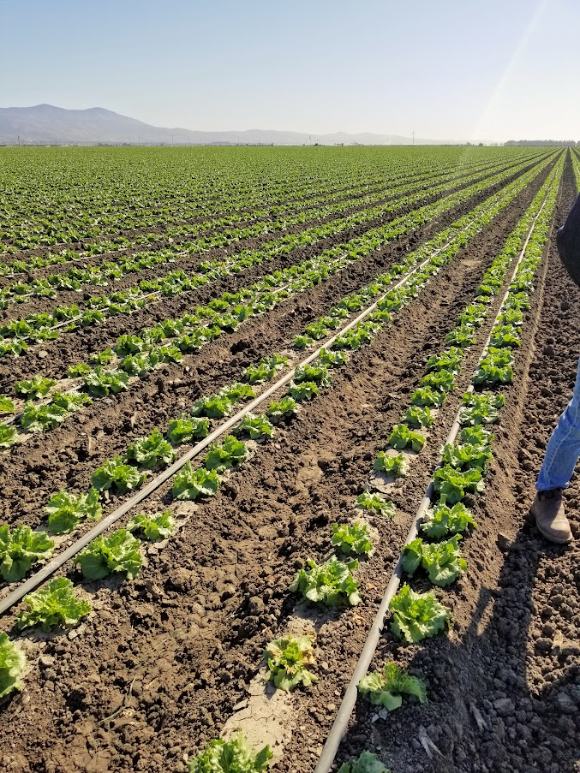
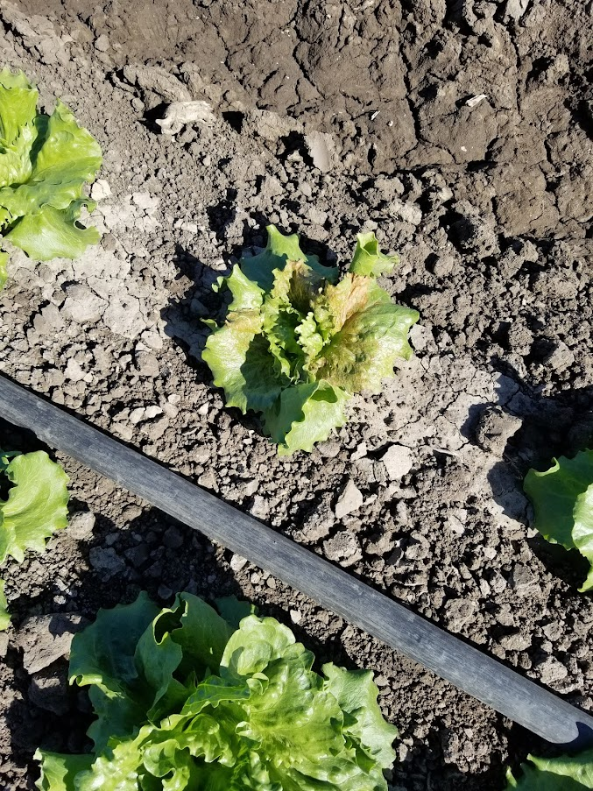
February 2021

Slide 10
June 2021
Organic lettuce

Slide 11
INSV and Pythium Task Force
Industry Monitoring Program 2021
Representative sample of growers reported disease development over the season
Disease incidence mapped

Slide 12
INSV and Pythium Task Force
Industry Monitoring Program 2021
Estimate of disease impact in 2021
Approximately one third of all lettuce plantings had some level of damage from INSV and/or Pythium
Organic impacted more than conventional
Very high pest management costs
Fall plantings most impacted
INSV, Pythium, and Fusarium found in hard hit fields

Slide 13
INSV and Pythium Task Force
Industry Monitoring Program 2021
Contributing Factors to Less Damage than 2020
Aggressive vector control which may not be sustainable
Lannate and Radiant
Aggressive weed management
Planting adjustments
Virus moved with the plantings
Below normal temperatures entire season
Models point to a warming climate

Slide 14
INSV and Pythium Task Force
Science Based Long Term Solutions
Research on this disease complex
Interaction of diseases
Why are they often found together?
Environmental triggers poorly understood
New technologies to monitor and to control vector
Team of local scientists working with growers
Funding in SB 170 critical

